Slide 1
Laser security system
laser security system is an advanced intrusion detection mechanism that employs laser beams and light sensors to monitor and protect premises. These systems create invisible barriers by projecting laser light across designated areas.
Laser security system is an advanced intrusion detection mechanism that employs laser beams and light sensors to monitor and protect premises. These systems create invisible barriers by projecting laser light across designated areas.
Laser security systems typically consist of a laser light source and a light-dependent resistor (LDR) sensor. The laser emits a beam that, when interrupted, causes a change in the light intensity received by the LDR. This change is detected by the system, which then activates an alarm to alert of a potential intrusion.

Slide 2
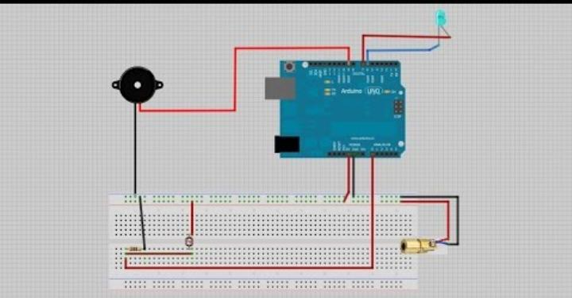
Block diagram

Slide 3
Overview about laser security system
1. Laser Source: Emits a continuous laser beam directed across the monitored area. 2. Light Sensor (LDR): Positioned to receive the beam; any interruption in the beam alters its resistance. 3. Signal Processing Circuit: Processes the change in resistance from the LDR, often using a comparator circuit to detect significant variations. 4. Control Unit: Interprets the processed signal and determines if it indicates an intrusion. 5. Alarm System: Activates an alarm (e.g., buzzer or siren) upon confirming an intrusion. 6. Power Supply: Provides necessary power to all components.

Slide 4
Advantages of laser security system
High Precision and Sensitivity: Laser beams can detect the slightest movement within their detection zone, offering high accuracy in identifying intrusions. 2. Non-Intrusive Detection: Lasers can be used to monitor an area without physical contact, making them ideal for protecting sensitive areas like museums, data centers, and restricted zones. 3. Long Detection Range: Laser systems can cover large areas and can be used to detect movement over significant distances, such as perimeters or long hallways. 4. Enhanced Security: Laser systems can be combined with other technologies, such as alarms or cameras, to create a layered security approach. They are effective in areas where traditional security methods (like motion detectors or cameras) may be less effective. 5. Low Maintenance: Once installed, laser systems typically require minimal maintenance compared to other types of security systems, reducing operational costs.

Slide 5
Dis advantages
1. Environmental Sensitivity: Laser beams can be affected by environmental conditions such as fog, smoke, rain, or dust. These factors can interfere with the laser’s ability to detect movement accurately, leading to false alarms or missed detections. 2. Limited Coverage Area: While lasers are precise, their detection range can be limited to a specific line of sight or zone. This means they may not be suitable for large, open areas unless multiple sensors are used, increasing the complexity of the system. 3. Vulnerability to Obstructions: Laser beams can be blocked or disrupted by physical objects, such as people or large obstacles. If something crosses the laser path, it may prevent the system from detecting potential intruders. 4. High Installation Cost: Laser security systems can be more expensive to install, especially if they require specialized equipment or customization for a specific area. This can make them less cost-effective for some applications. 5. Technical Expertise: Setting up and maintaining a laser security system often requires specialized knowledge. Improper installation or configuration can reduce the system’s effectiveness or cause it to malfunction

Slide 6
Applications
1. Home Security: Laser security systems can be installed near doors or windows to detect intruders, providing an additional layer of protection for residential properties. 2. Bank Vaults: Protecting valuables by setting up a laser-based alert system ensures that any unauthorized access attempts are promptly detected. 3. Warehouses: Securing storage areas with a simple, cost-effective alarm system helps prevent unauthorized access and potential theft. 4. Schools and Offices: Preventing unauthorized access to restricted areas within educational institutions and workplaces enhances overall security. 5. Personal Safety: Setting up alarms for personal security at home ensures immediate alerts in case of unauthorized entry. 6. Safety Lockers: In homes, laser security systems can act as an additional layer of security for safety lockers, even if the locker’s code is compromised.

Slide 7
Thanking you

